Slide 1
Built-In Methods

Slide 2
Contents
Methods of Primitives
Numbers
Strings
Indexed Collection
Arrays
Keyed Collection
Map & WeakMap
Set & WeakSet

Slide 3
Numbers : methods
let num = new Number(2.3);
num.toString(); // “2.3”
num.toExponential(); // 2.3e+0
Will convert into e
num.toPrecision(3); //2.30
num.toFixed(3); //2.300
Difference is toFixed() count starts after decimal point but toPrecision() count starts before decimal point.
0.1+0.2 // 0.30000000000000004
0.3 == (0.1+0.2).toFixed(1) //true
0.3 == 0.1+0.2 //false

Slide 4
Numbers : Math Rounding
Math.floor (//1.2 -> 1 //1.9->1 //1->1)
Math.ceil (//1.2 -> 2 //1.9->2 //1->1)
Math.round (//0.5 -> 1 //1.2 -> 1)
>=.5 increase or <.5 decrease
Math.trunc (//1.9 -> 1 //1.2 -> 1)

Slide 5
Numbers : Utility Methods
isNaN(“a”) //true
isFinite(infinite) // false
parseInt(“100px”) //100
https://www.w3schools.com/jsref/tryit.asp?filename=tryjsref_parseint
parseFloat(“12.5cm’) //12.5
parseFloat(“cm12.5’) //NaN
https://www.w3schools.com/jsref/tryit.asp?filename=tryjsref_parsefloat

Slide 6
String: Methods
let str = “hello”;
Accessing characters:
In two ways:
str[0] // “H”
str.charAt(0) //”H”
Note : str[121] //undefined but str.charAt(121) //empty string
Changing Cases:
str.toUpperCase(); // HELLO
str.toLoweCase(); //hello

Slide 7
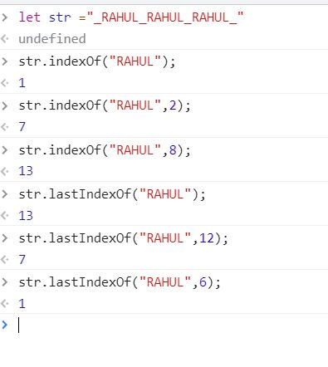
Search of String:
str.indexOf(), str.lastIndexOf()
String assertion:
str.includes(“el”); // true
str.startsWith(“h”); //true
str.endsWith(“o”); //true

Slide 8
Substring() vs Slice():
Common Result
Both give same results in the given cases.
If start == stop, both returns an empty string
If stop is omitted, both extracts characters till the end of the string
If any argument is greater than the string’s length, the string’s length will be used in that case.
Separate results of substring()
If start > stop, then function swaps both arguments.
If any argument is negative or is NaN, it is treated as 0.
Separate results of slice()
If start > stop, This function will return an empty string. (“”)
If start is negative, It sets char from the end of string, like substr().
If stop is negative, It sets stop = string.length – Math.abs(stop) (original value)

Slide 9
ASCII characters:
“z”.codePointAt(0); //122
“Z”.codePointAt(0); // 90
String.fromCodePoint(90); //Z
String.fromCodePoint(122); //z
Other methods:
str.trim(), str.repeat(), str.concat(), str.replace(“search”, “replace”), str.match(regex), str.split(), str.replaceall()

Slide 10
Array: Methods
https://array-methods.github.io/
Two ways:
let arr = new Array(“eat”, “sleep”);
let arr = [1,2,3,4,5];
Add/Remove:
Push, unshift() //add front
Pop, shift // remove front
Splice: ~practice~ (arr.slice also available just like string)
arr.splice(start, ?deletecount, …items)
let arr = ["I", "study", "JavaScript"];
arr.splice(2, 0, "complex", "language");
alert( arr ); // "I", "study", "complex", "language", "JavaScript"

Slide 11
Search Strings:
indexOf, lastIndexOf, includes,
Search Strings:
find, findIndexOf, filter, arr.some, arr.every,
Transform Array:
map, sort, reverse, split, join, reduce, reduceRight
Other methods:
arr.concat, arr.fill, arr.repeat

Slide 12
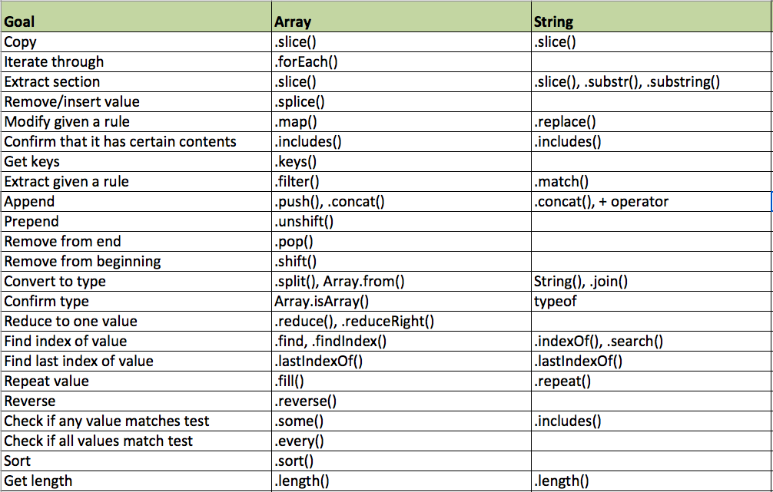

Slide 13
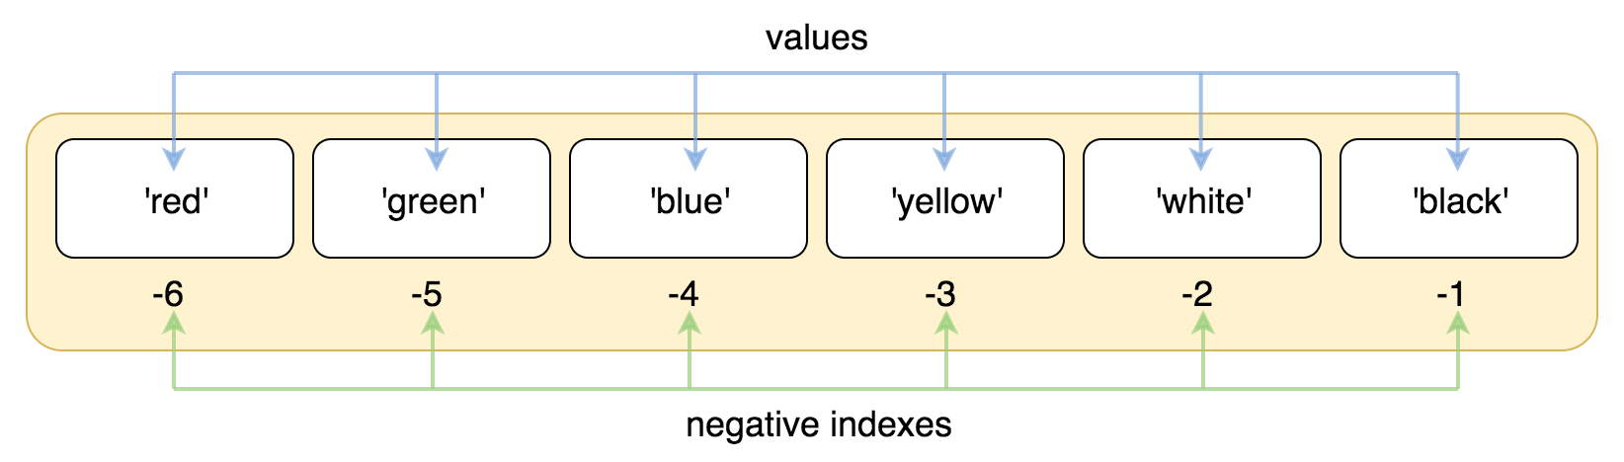

Slide 14
Map: Methods
Set : set of values without keys;
let item = new Map()
Item.set(key, value);
Item.get(key);
Item.has(key);
Item.delete(key);
Item.clear();
Item.size;
Iteration
Item.keys(), Item.values(). Item.entries()

